Slide 1
Detailed and adaptive surface reconstruction of implicit models
Bernhard Manfred Gruber
2014-12-10

Slide 2
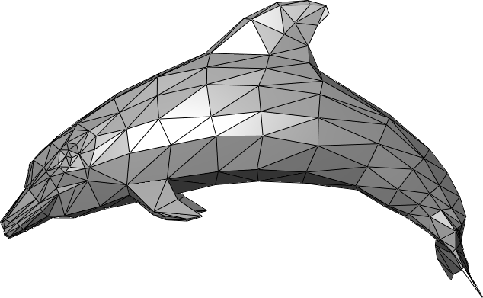
What are implicit models?
Explict surface models
Implict surface models
Parametric
Functional (iso surface)
Boundary Representation
Constructive Solid Geomtry
Sweeps
...
http://en.wikipedia.org/wiki/Triangle_mesh#mediaviewer/File:Dolphin_triangle_mesh.png

Slide 3
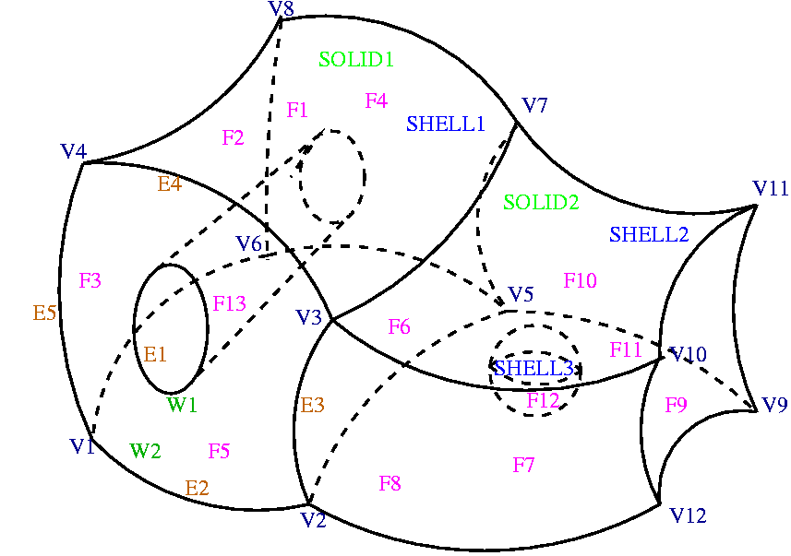
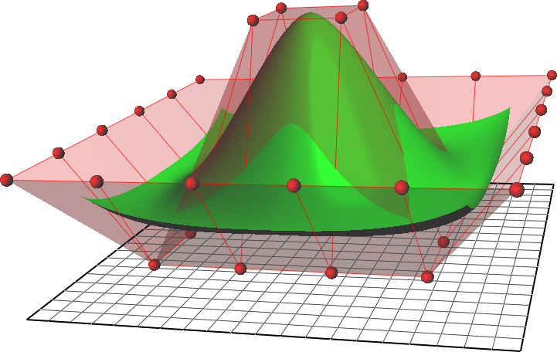
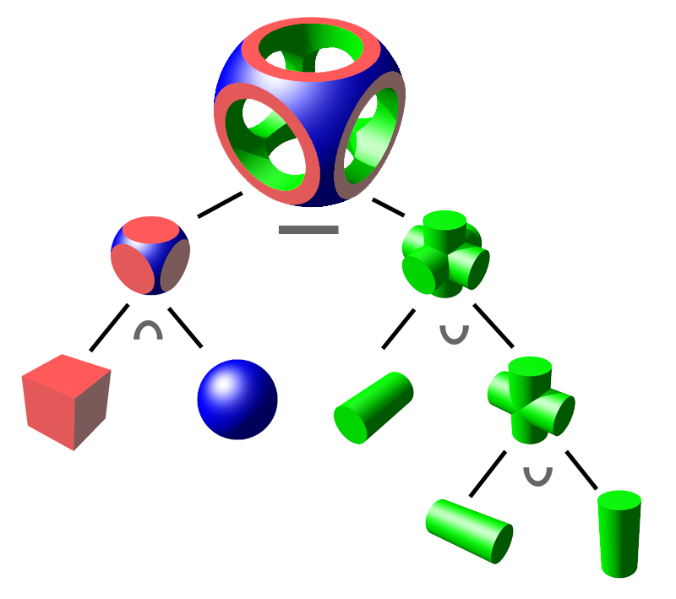
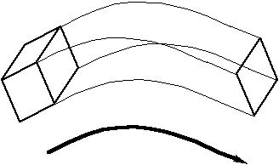
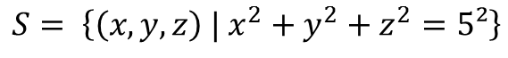
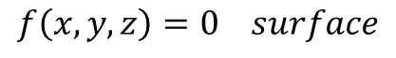
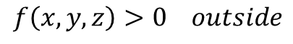
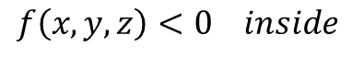
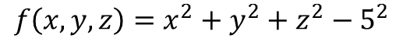
What are implicit models?
$$f\left(x, y, z\right)=x^{2}+y^{2}+z^{2}−5^{2}$$
$$f\left(x, y, z\right)<0 inside$$
$$f\left(x, y, z\right)>0 outside$$
$$f\left(x, y, z\right)=0 surface$$
$$S= \left\{\left(x, y, z\right) | x^{2}+y^{2}+z^{2}=5²\right\}$$
http://en.wikipedia.org/wiki/Constructive_solid_geometry#mediaviewer/File:Csg_tree.png
https://www.ljll.math.upmc.fr/perronnet/mit/mit.html
http://de.wikipedia.org/wiki/Non-Uniform_Rational_B-Spline#mediaviewer/File:NURBS_surface.png
http://www.cs.cf.ac.uk/Dave/3DVG/IMAGES/sweep.gif

Slide 4

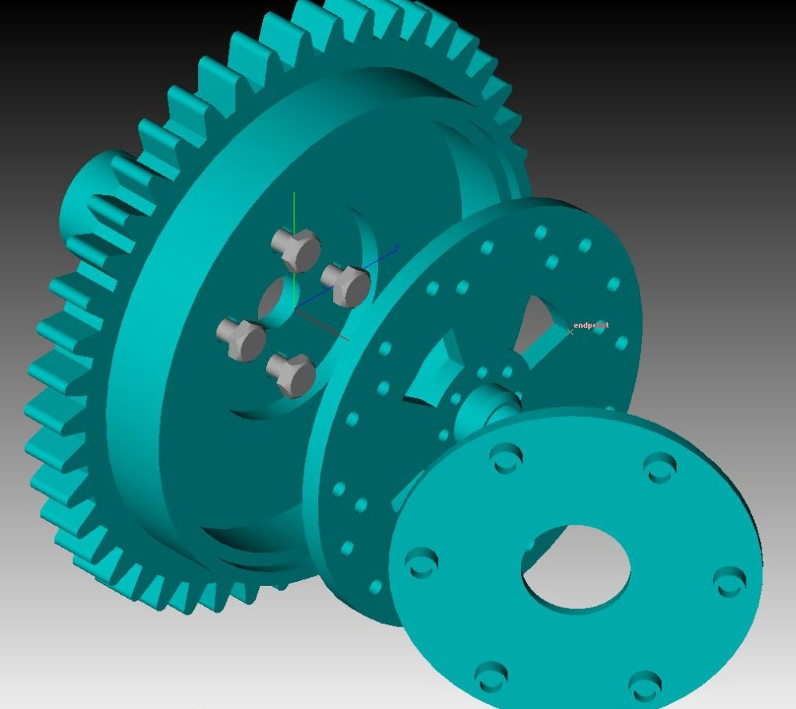
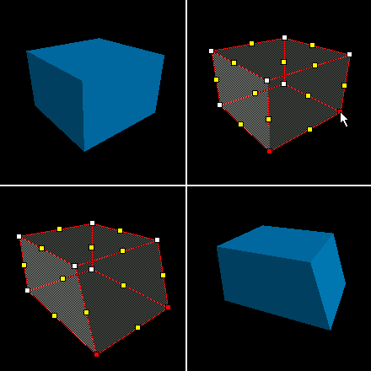
Motivation
Explicit surfaces
Implicit surfaces
Wide support
Render
Process
Store
Edit
Distribute
Sell
...
Exact
Expressive
Small memory
Ray tracing
...
https://www.khronos.org/news/logos
http://blog.bestsoftware4download.com/wp-content/uploads/2010/04/TurboCAD-MAC.jpg
https://developer.valvesoftware.com/w/images/2/29/VertexEdit1.png

Slide 5


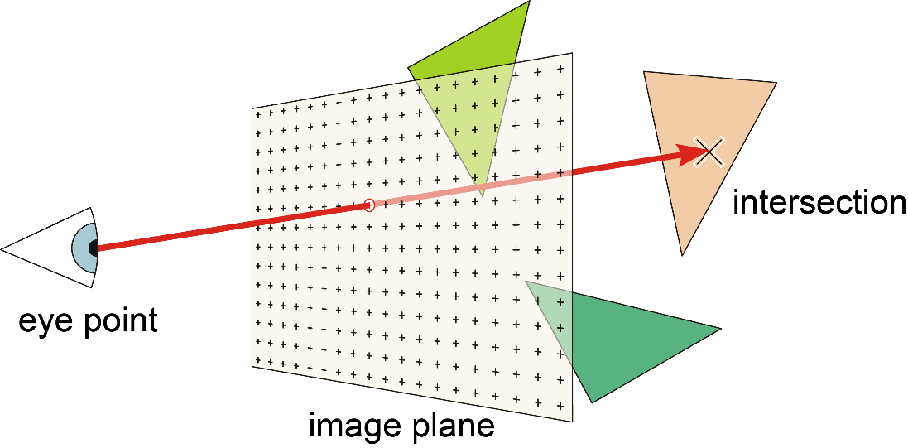
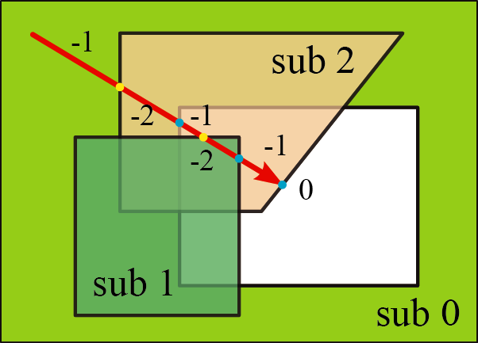
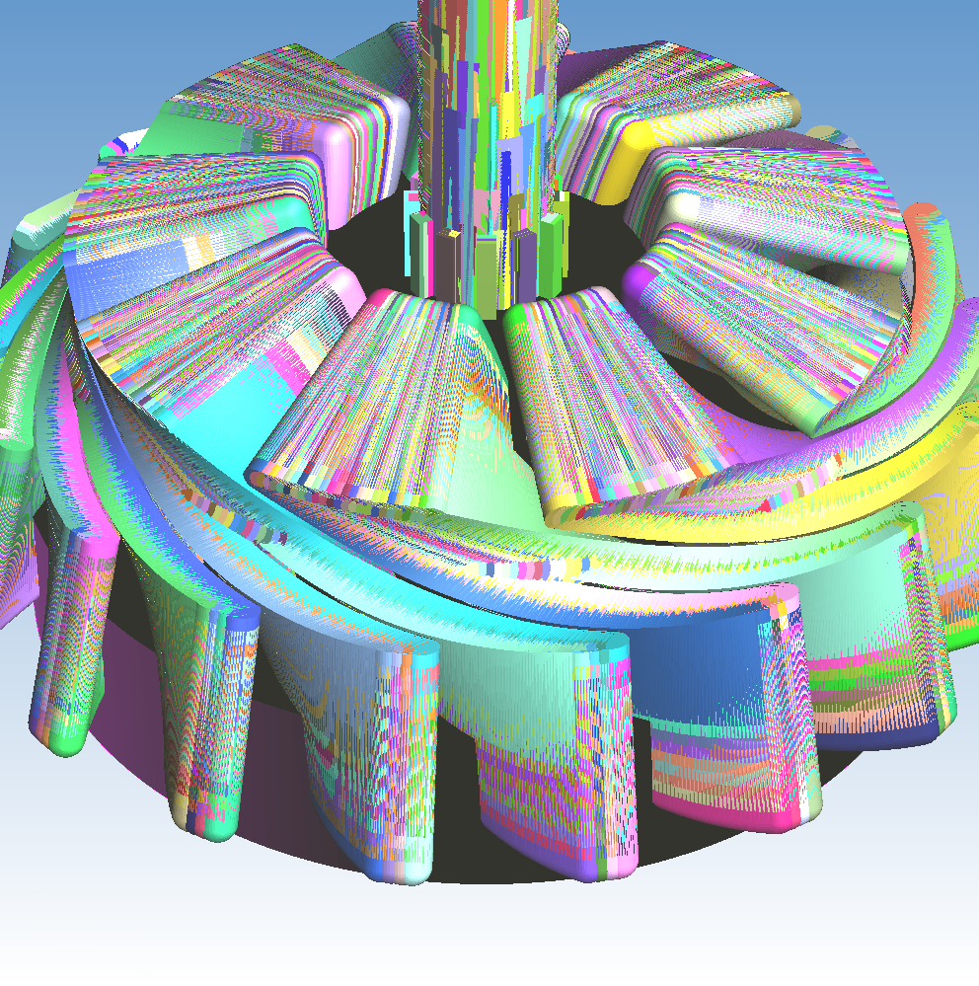
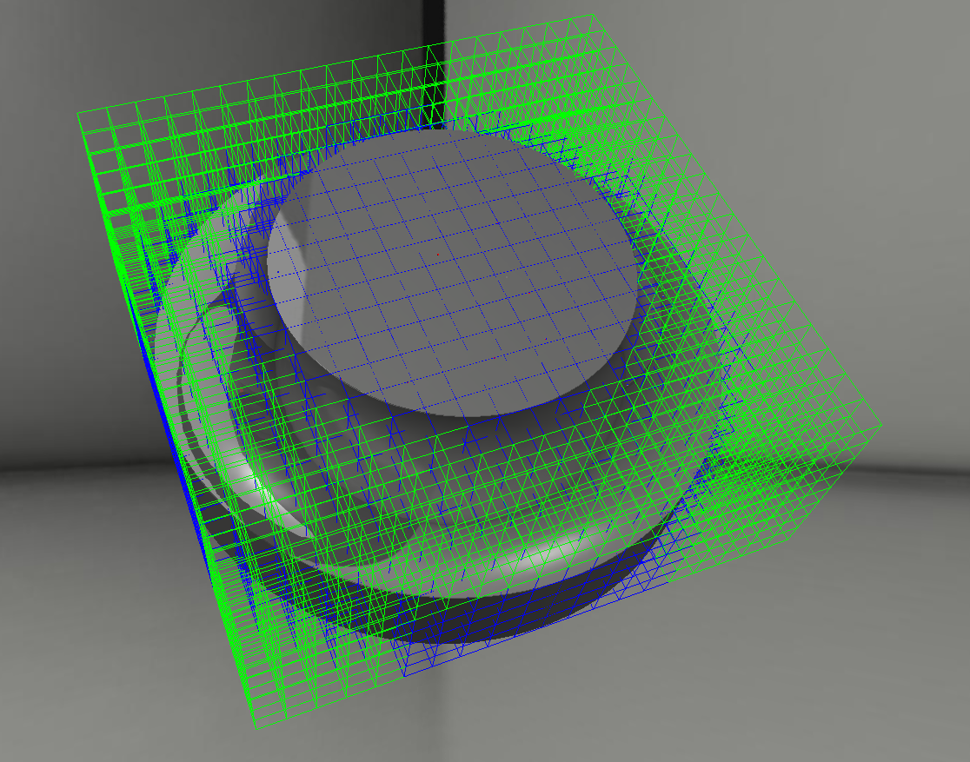
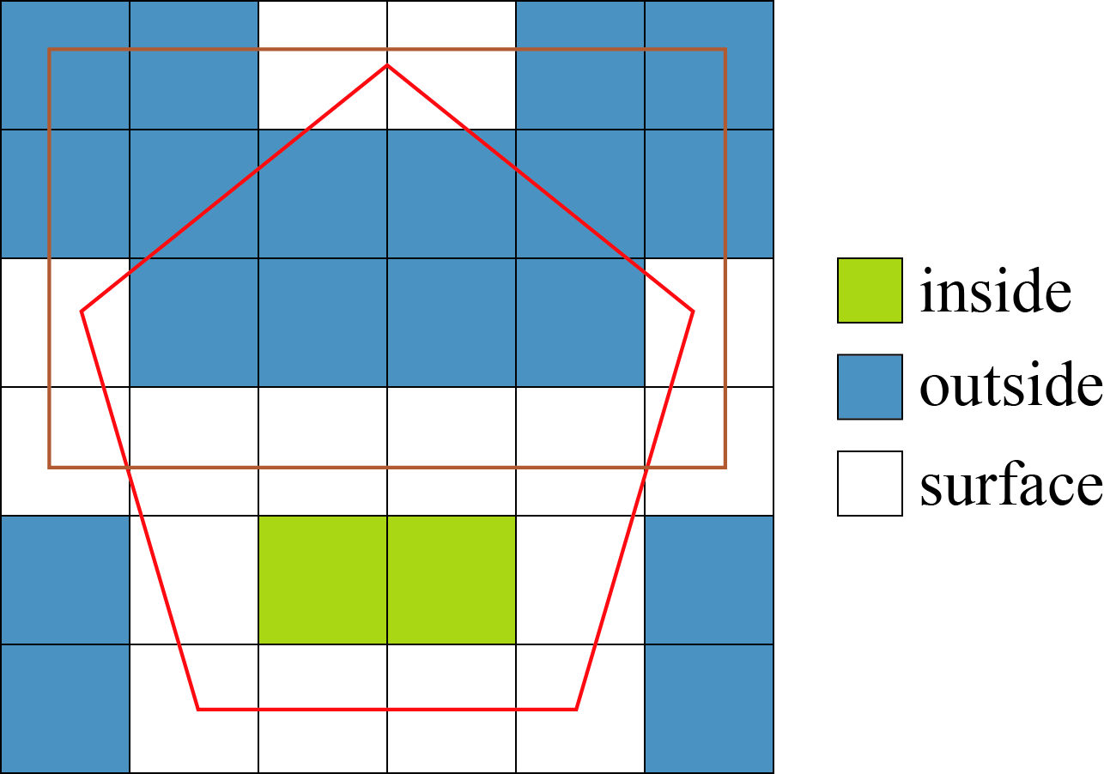
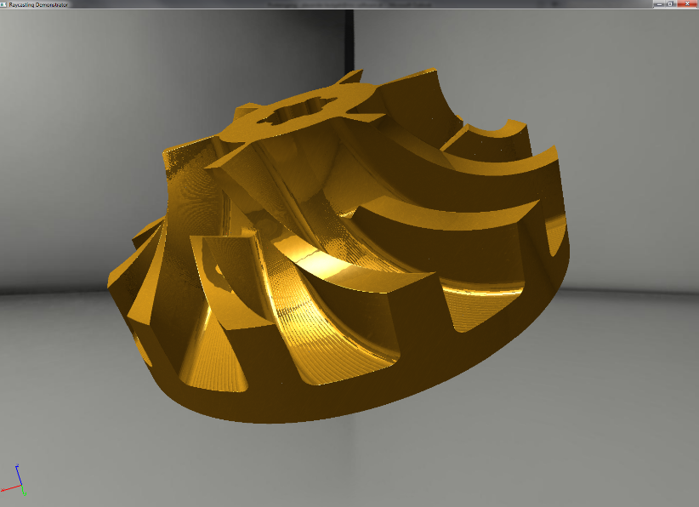
Previous work - Enlight

Slide 6
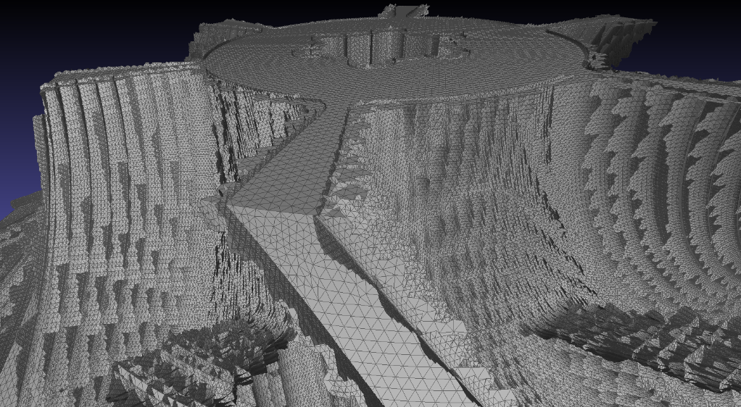
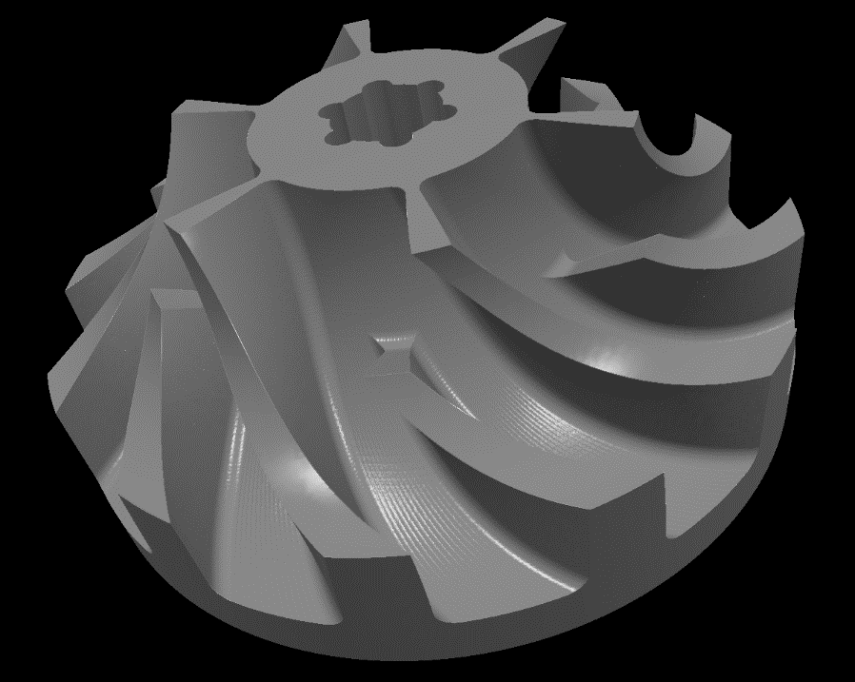
Enlight
Swept volumes
Data model
Raycast

Slide 7
Problem statement
Surface mesh extraction from Enlight’s data model
Determine state of the art
Prototypic implementation and comparison runtime, memory, complexity, visual quality, errors, divergence, numeric, mesh quality, feature conservation, adaptivity
Intensive testing on selected models. Is there a "best" algorithm? Under which circumstances? How to select best suited algorithm?

Slide 8
Approaches
Direct intersection
Point cloud based
Voxel based
Dexel based

Slide 9
Direct intersection
Most naïve, probably most accurate
David Rosen, Seamless Intersection Between Triangle Meshes, 2008

Slide 10
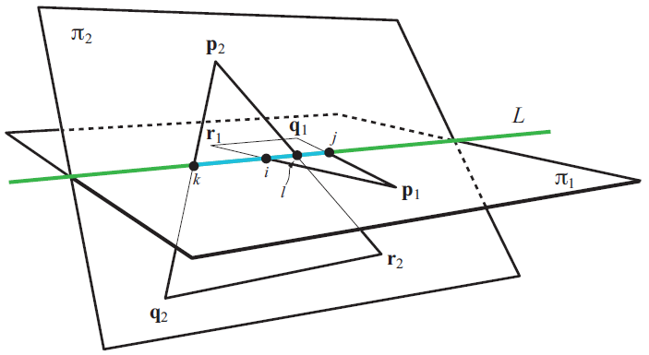
Triangle triangle intersection
Tomas Möller, A fast triangle-triangle intersection test, 1997
http://lib.znate.ru/docs/index-40240.html?page=3

Slide 11
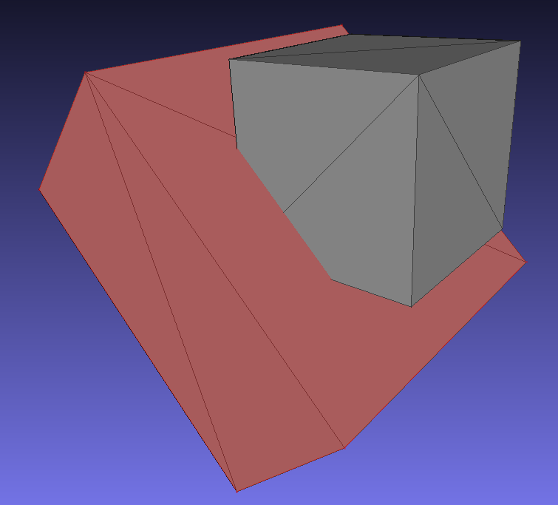
Cube vs. cube

Slide 12
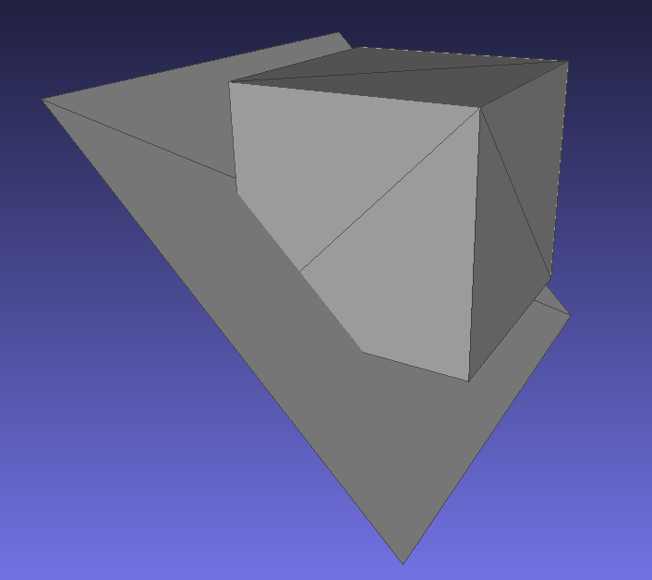
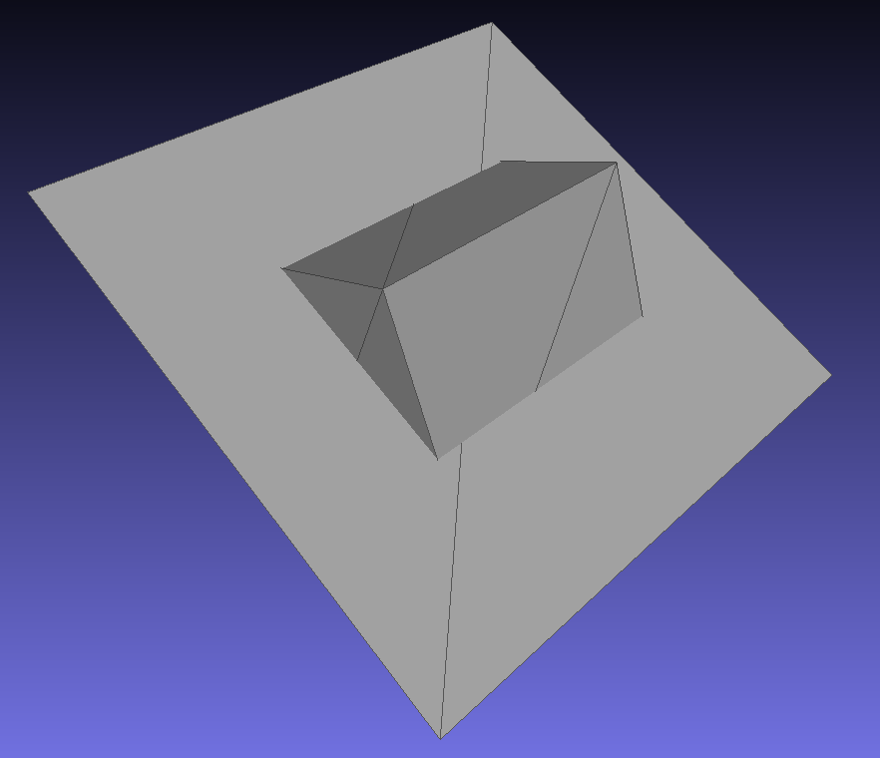
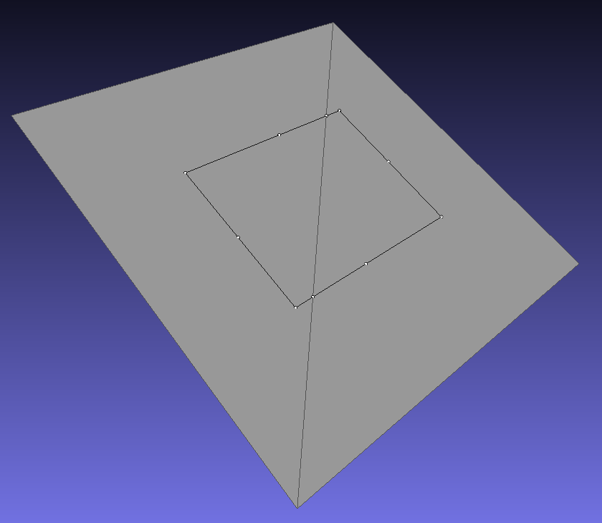
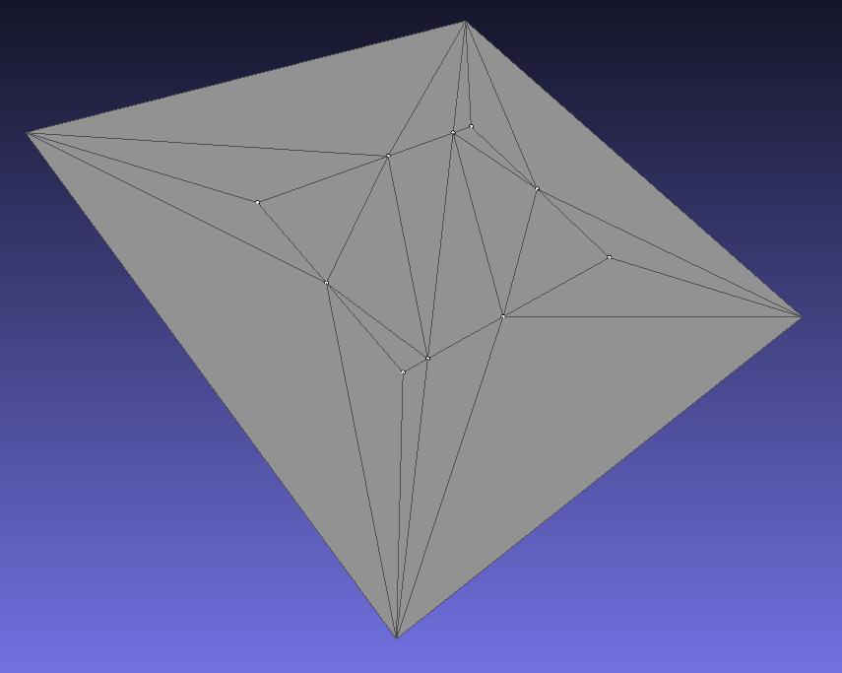
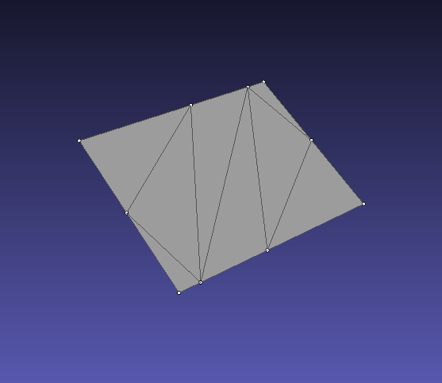
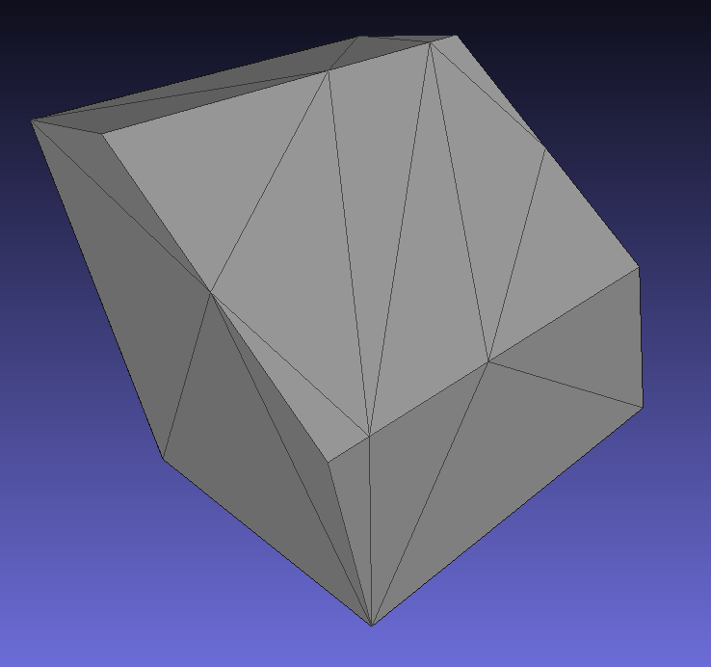

Slide 13
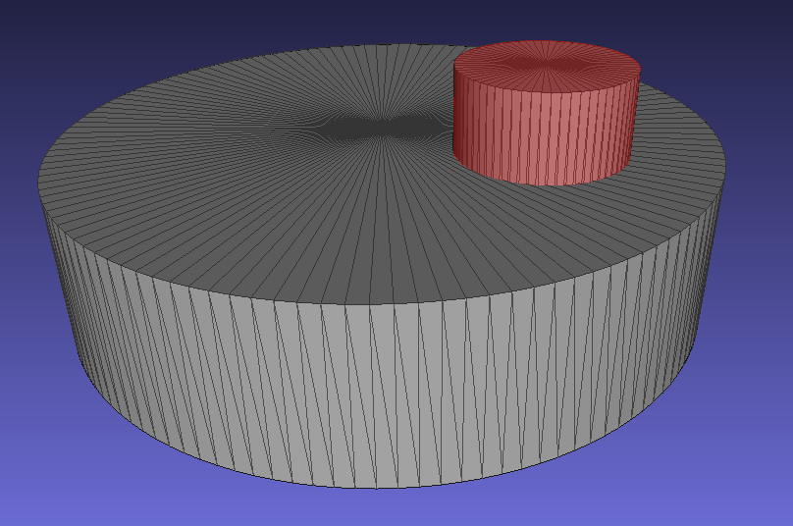
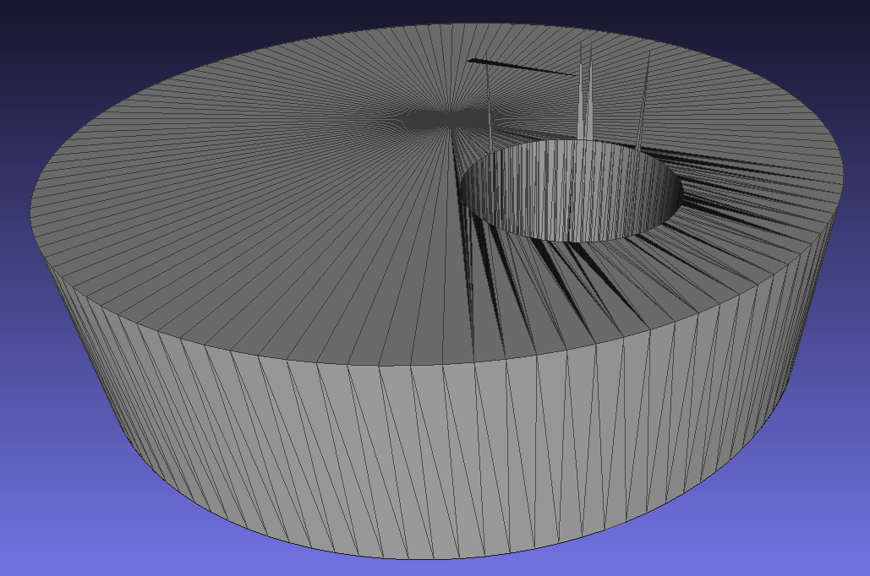
Cylinder vs. cylinder

Slide 14
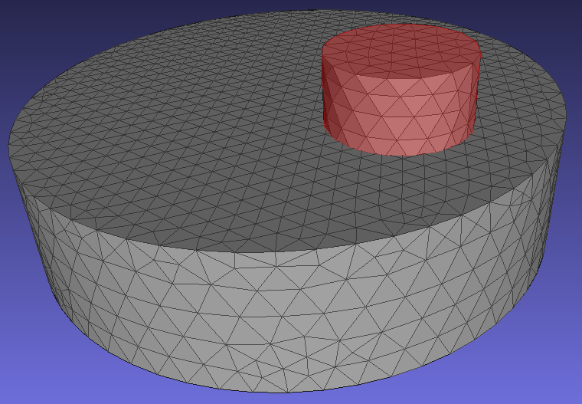
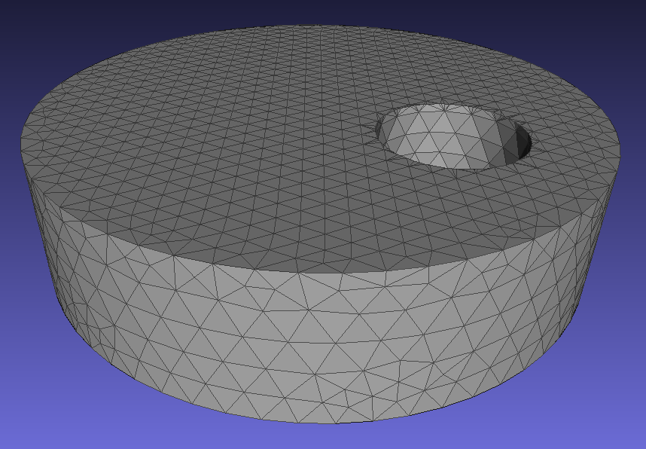
Cylinder vs. cylinder - Delaunay

Slide 15
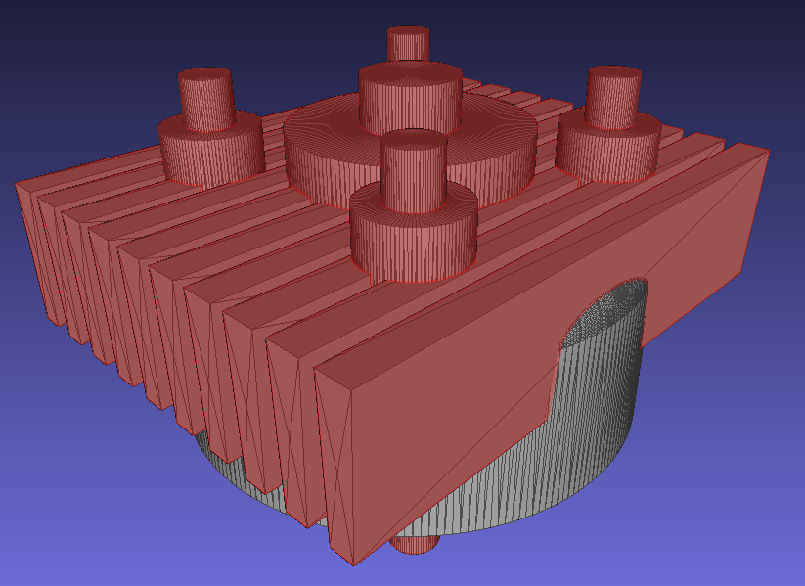
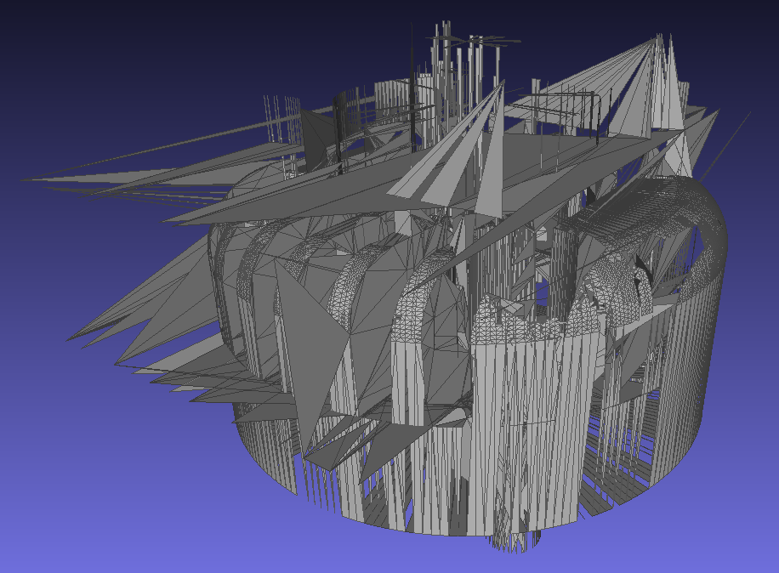
Cylinder head

Slide 16
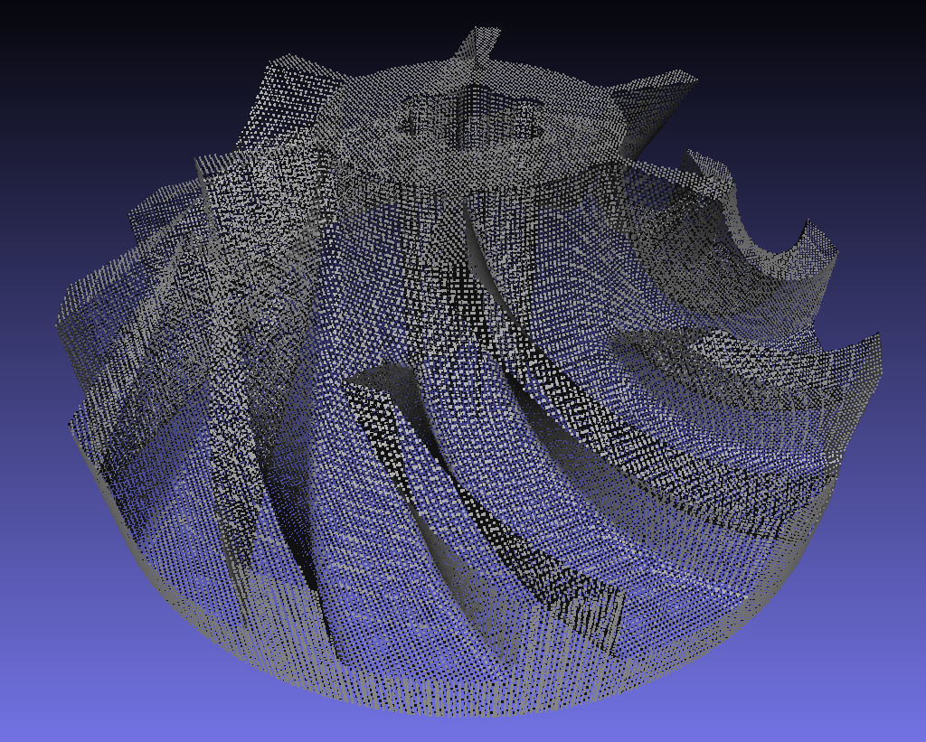
Point cloud based
Sample surface, e.g. 3 orthongal raycasts, reconstruct surface from points

Slide 17
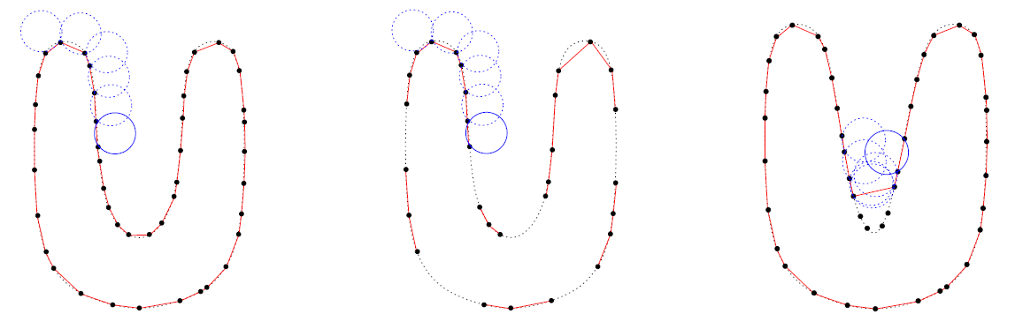
Surface reconstruction from point cloud
Fausto Bernardini et al., The ball-pivoting algorithm for surface reconstruction, 1999
…

Slide 18
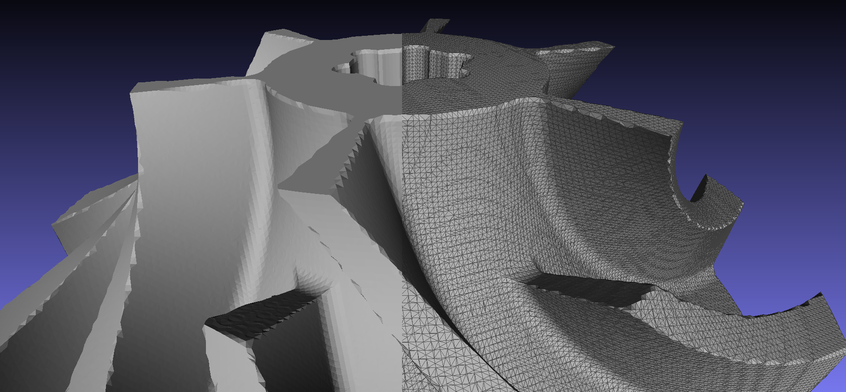
Ball pivoting algorithm

Slide 19
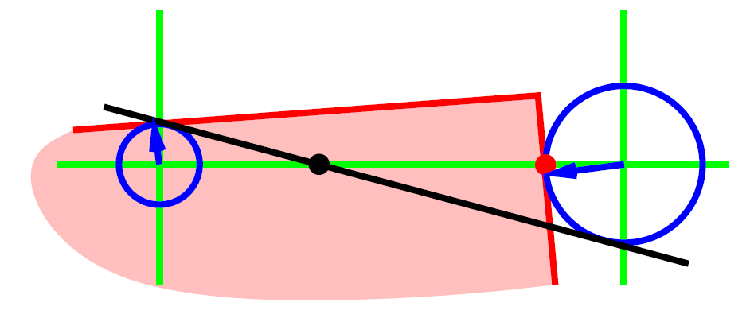
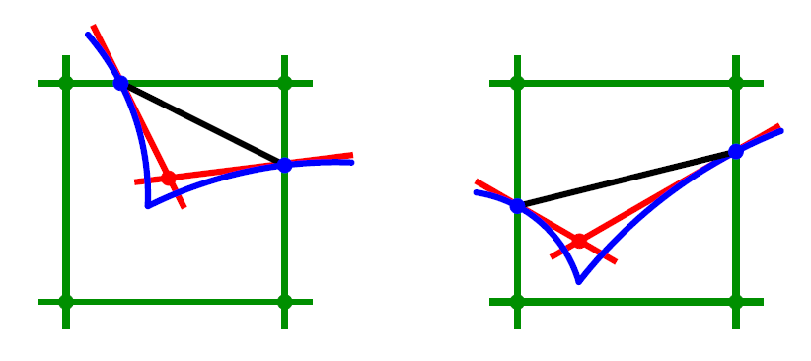
Voxel based
Leif Kobbelt et al., Feature sensitive surface extraction from volume data, 2001

Slide 20
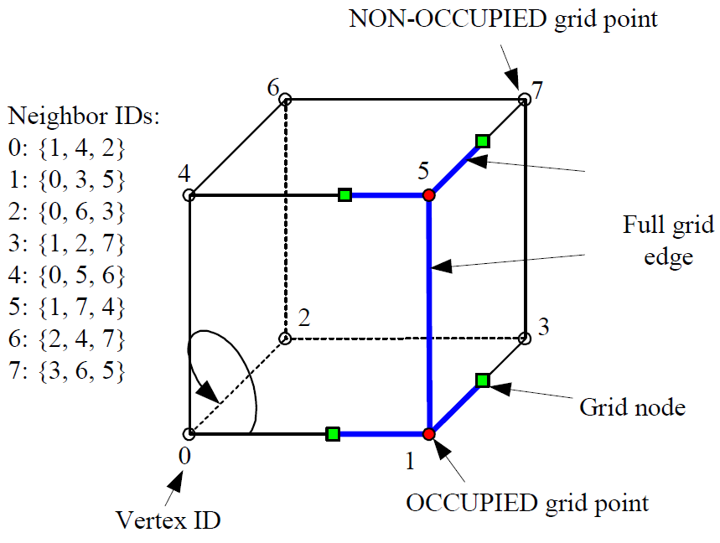
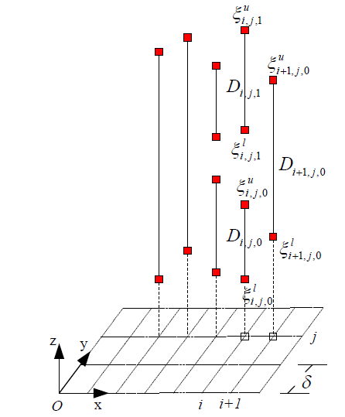
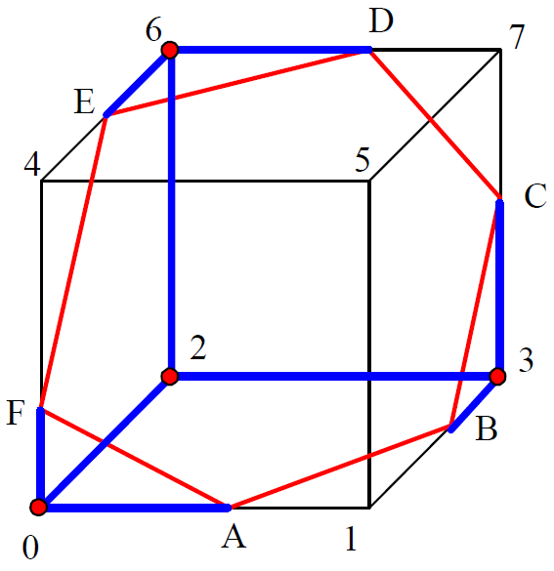
Dexel based
Yongfu Ren et al., Feature conservation and conversion of Tri-dexel volumetric models to polyhedral surface models for product prototyping, 2008

Slide 21
Goal
Implement presented approaches
Create appropriate test suite (models)
Evaluate algorithms
Try to find "best" algorithm or hybrid
Development on "best" algorithm will be continued at RISC …
Notes:
Criteria as in problem statement, maybe also parallelization

Slide 22
Schedule
Time | Milestone
October | DPR3: Technical lecture, infrastructure code, some test models
November | Exposè, direct triangle-triangle intersection
December | DPR3: Thesis introduction, point cloud based approaches
January | Voxel based approaches
February | Dexel based approaches
March | Comparing implementations, introductory and fundamental chapters
April/May | Implementation chapters, adjusting implementations, more test models
June | Finishing touches and submission

Slide 23
Thank you!
Questions?

